Slide 1
Importance of a Framework to Support PK MTSS & Social Emotional Learning
April 11, 2024 8-9:30am
Rob Corso, Executive Director
Hope Beissel, Certified Consultant
Pyramid Model Consortium

Slide 2
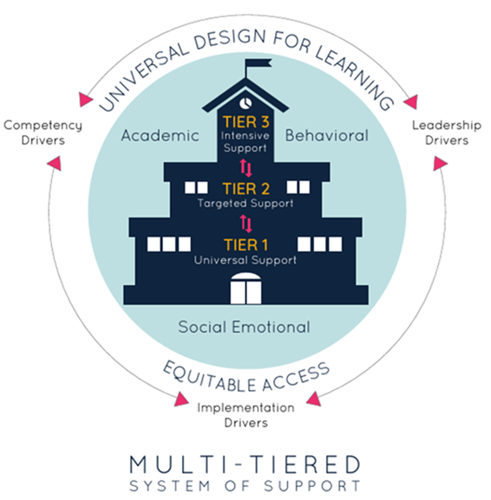
Agenda
Review of Data to Set the Stage
The Importance of Tiered Interventions (MTSS/PBIS)
Comprehensive Approach From PK-through High School using Implementation Science
Problem Solving around Challenges
Current Status in MA
Differences and Similarities Between PreK MTSS & K-12 MTSS

Slide 3
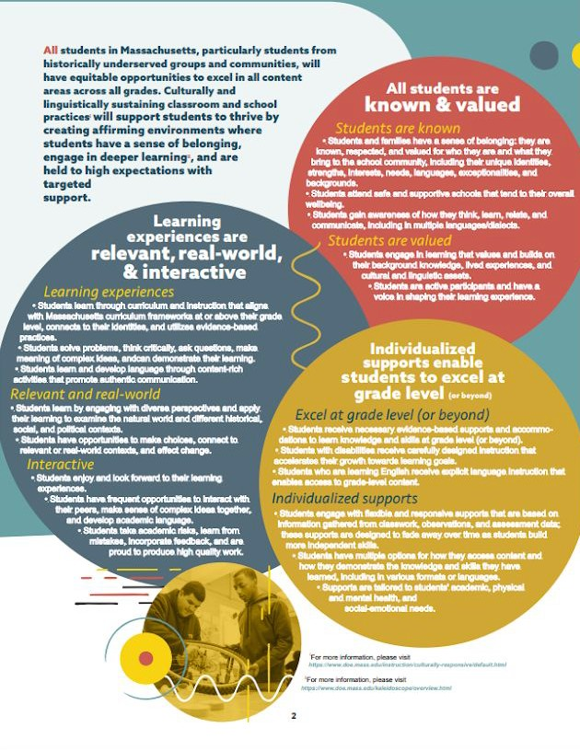
DESE’s Educational Vision
2
What does that look like for students?
What principles guide our work?
All students
Are known and valued
All students in Massachusetts, particularly students from historically underserved groups and communities
Learning experiences
Are relevant, real-world and interactive
Culturally and linguistically
sustaining classroom and school practices
High expectations with targeted support
Individualized supports
Enable students to excel at grade level and beyond

Slide 4
When you hear “PK MTSS,” what do you think of?
This Photo by Unknown Author is licensed under CC BY-SA

Slide 5
US DOE Office of Civil Rights 2017-2018
In 2017-2018, 2,822 preschoolers received one or more out-of-school suspensions.
Black preschool children accounted for 18.2% of total enrollment but 43.3% of one or more out-of-school suspensions.
Expelled at rates twice their share of enrollment (38.2% expelled)
Preschool boys were suspended and expelled much more often than girls
Black preschool boys received both suspensions (34.2%) and expulsions (30.4%) more than 3x their enrollment (9.6%)
Preschool students who were served under IDEA accounted for 22.7% of total pre-school enrollment but accounted for 56.9% of preschool students who were expelled.
Student Discipline & School Climate in Public Schools Report, 2017-2018,
Civil Rights Data Collection. Data available at https://civilrightsdata.ed.gov.

Slide 6
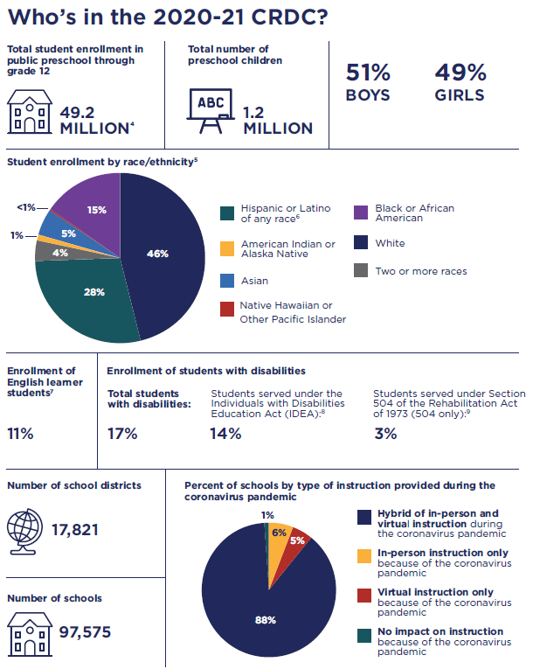
3 years later……National Data
Student Discipline & School Climate in Public Schools
2020-2021 Civil Rights Data Collection
US Department of Education /Office for Civil Rights

Slide 7
During the 2020-21 school year, there were 1.2 million children enrolled in preschools. Nearly 1,000 public preschool children received one or more out-of-school suspensions, and approximately 220 preschool children were expelled. Preschool boys represented 54% of the 1.2 million students enrolled in public preschool. However, preschool boys accounted for 81% of preschool children who received one or more out-of-school suspensions and 85% of preschool children who were expelled. Preschool children with disabilities served under IDEA represented 24% of preschool enrollment, but 34% of preschool children who received one or more out-of-school suspensions and 62% of preschool children who were expelled.
National Preschool Data

Slide 8
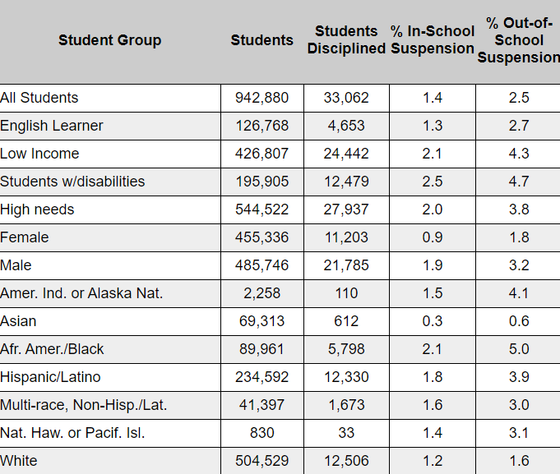
Massachusetts DOE 2022-2023 Student Discipline Data Report (All Offenses)
Data available at: https://profiles.doe/mass.edu/ssdr

Slide 9
The Importance of Tiered Interventions
MTSS
3 yr olds-12th grade
PK Social Emotional
Pyramid
Universal Design for Learning
Developmentally Appropriate Practice
Diversity-Equity-Inclusion
Culturally Responsive Practices
K-12 Social Emotional
PBIS
Academic
Behavioral

Slide 10
Definitions
A Multi-Tiered Systems of Support (MTSS) is a framework for how school districts can build the necessary systems to ensure each and every student receives a high-quality educational experience.
Universal design for learning (UDL) is a framework that reduces barriers in instruction, proactively provides appropriate accommodations and supports, and allows for high-achievement expectations for all students, regardless of their unique strengths and challenges.
SEL is the process through which students acquire and effectively apply the knowledge, attitudes, and skills necessary to understand and manage emotions, set and achieve positive goals, feel and show empathy for others, establish and maintain positive relationships, and make responsible decisions.
PBIS is an evidence-based framework for supporting students behavioral, academic, social, emotional, and mental health. PBIS is a subset of PBS. PBIS is used interchangeably with SW-PBS.
The Pyramid Model is a framework of evidence-based practices for promoting young children’s healthy social and emotional development. Pyramid has also been referred to a PW-PBS.
MTSS
UDL
SEL
K-12 SEL
PBIS
PK SEL
Pyramid

Slide 11
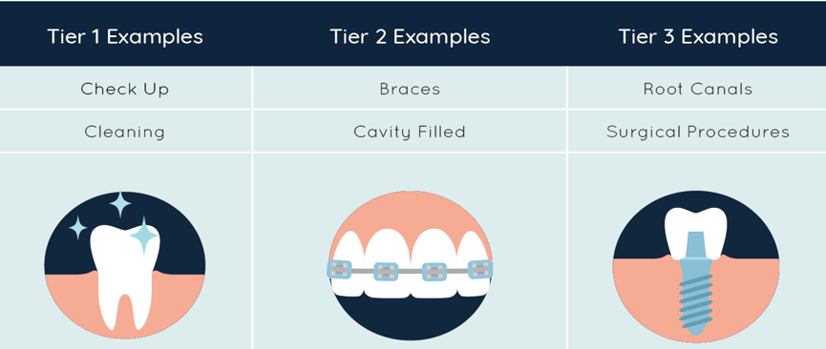
Multi-Tiered Systems in PK & K-12
Tiers are not a location and students do not belong to “a tier”
All students have access to all Tiers of support
All students are capable of grade-level learning with adequate support.
UDL is proactively embedded so all students can make choices in an equitable and culturally sustaining manner.
Multiple means of engagement
Multiple means of representation
Multiple means of action & expression.

Slide 12
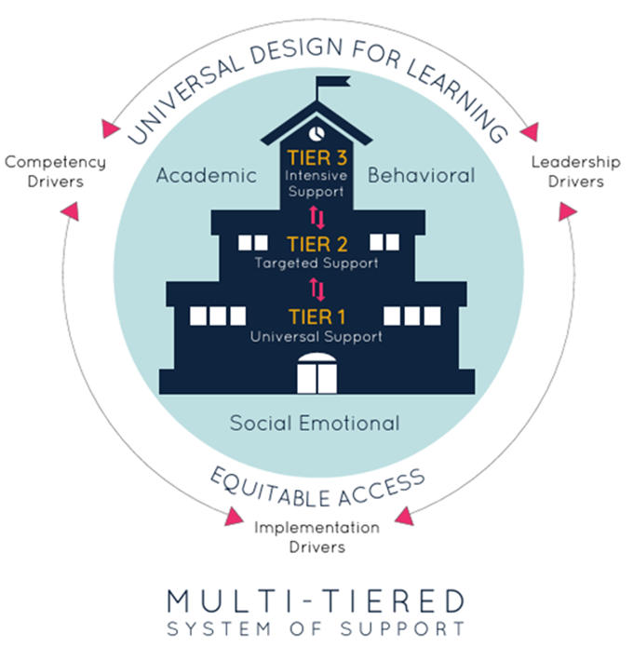
MTSS in MA
UDL/DAP/DEI/CRP
MTSS/Social Emotional in PK
MTSS/Social Emotional in K-12

Slide 13
Introduction to Implementation Drivers

Slide 14
4 Essential Components of Implementation
Leadership Team
Training/PD
Coaching
Data Collection & Use

Slide 15
What does Social Emotional MTSS Look Like For You?
What does social emotional MTSS implementation look like in your school?
What training around social emotional MTSS do staff receive?
What coaching around social emotional MTSS do staff participate in?
What data around social emotional MTSS is collected and how is it used?

Slide 16
PK through 12th Grade MTSS Continuum
Systems
Leadership Team, Staff Buy-In, Family Engagement, Program-Wide Expectations, PD and Staff Support, Responding to Challenging Behavior, Monitoring Implementation & Outcomes
Practices
Schedules/Routines, Transitions, Engagement, Directions, Behavior Expectations, Collaborative Teaming, Emotional Competencies, Friendship Skills, Problem Solving, Self Regulation, Responding to Challenging Behaviors, Supporting Families.

Slide 17
What is Developmentally Different in PK SEL MTSS implementation?
Classroom Schedule
Rules & Expectations
Data Collection Tools
Responses to Challenging Behavior
Family Involvement
Role of the Office
Acknowledgement Systems

Slide 18
Outcomes for Educators, Children, Families
Outcomes for Educators
Shared language
Increased positive relationships with children and families
Outcomes for Children
Increased engagement
SE growth
Outcomes for Families
Increased teaming for families and teachers
Decrease in family concerns about safety and behavior at school
Improved capacity to handle challenging behavior
Increase in positive self esteem
Reduction in challenging behavior
Limited or eliminated rates of expulsion/suspension
Families feel more supported in preventing and addressing challenging behavior at home

Slide 19
Social Emotional MTSS in PK

Slide 20
What’s Happening in Massachusetts
Early Childhood (3-5) examples include:
School Aged (K-12) Examples Include:
PBIS implementation in school buildings
Professional Learning Communities
Tiered Supports
Social, Emotional, and Behavioral Academy (DESE)
MA SEL & Mental Health Grants
Develop Multi-Tiered Systems of Support
CPPI Grantees (EEC Funded)
Expanding access to inclusive settings
Consistent quality and aligning with K-3
Expanding access to preschool
PK MTSS-SEL Academy

Slide 21
Acknowledgement of Challenges & Need for Data
Challenges
Staff burnout
Staffing shortages
Increase in Challenging Behaviors
Shortage of resources
Stressed educational system
Data to Inform the System
Inclusive placements
Harsh discipline
English Language Learners (ELL’s)
ELL’s who have IEP’s, behaviors, etc.
Attendance

Slide 22
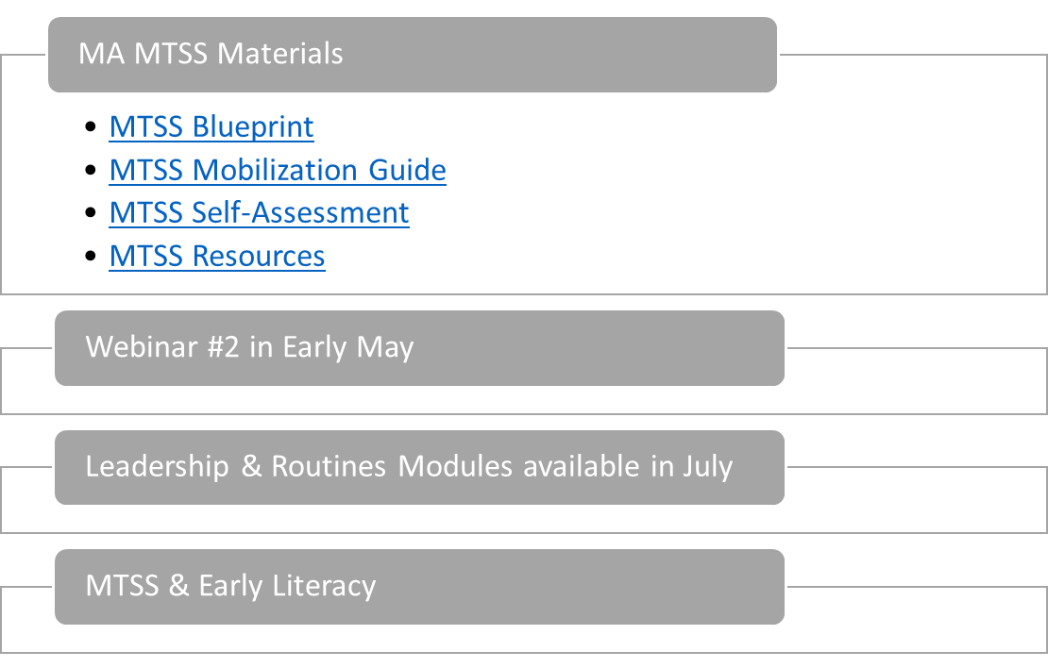
What Step will You Take?
What did you hear that you can act on?
What information can you share with colleagues?
What do you want to learn more about?

Slide 23
This Photo by Unknown Author is licensed under CC BY-SA
Questions/Comments:
Chris Pond
Behavioral & Mental Health & SEL Specialist & Foster Care Point Contact
Christine.A.Pond@mass.gov
Rob Corso
Executive Director, Pyramid Model Consortium
Rob.Corso@pyramidmodel.org

